Slide 1

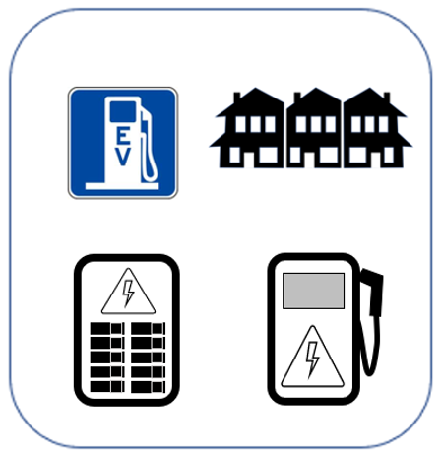

EV &
EV CHARGING BASICS
September 28, 2023
Tim Milburn
Notes:
Tim Milburn:
EV owner since 2014
95% home, wireless recharging
“Driving on Sunshine” since 2020
EV charging installation business (2012)
Steering Committee: US DOE / Chicago Area Clean Cities
Volunteer: Sierra Club Clean Energy and Clean Transportation
Project Advisor: Metropolitan Mayors Caucus EV Readiness Program
Activist, consultant, author and educator on Transportation Electrification

Slide 2
Agenda
Why?
EVs
EV Charging
Incentives
1: EV Charging for Residential and Commercial Energy Codes, US Dept of Energy, 2016
MFD = Multiple Family Dwelling
SFD = Single Family Dwelling

Slide 3
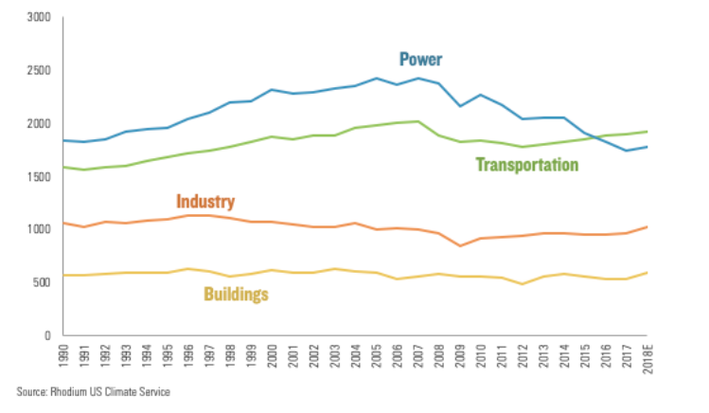
Transportation
Sustainability Challenge
United States
  5% of global population
  Consumes 30 % of global energy
  Generates 28 % of carbon emissions
Need to find ways to mitigate GHGs and other pollutants
US: CO₂ Equivalent
by Generation Sector
MM Tonnes/year
Notes:
Foreign oil carries the risk of protecting the oil, the trade deficit and national security
AFDC station counter
https://rhg.com/research/preliminary-us-emissions-estimates-for-2018/

Slide 4
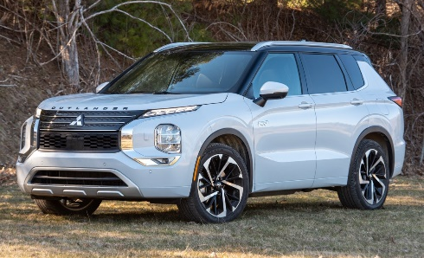
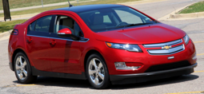
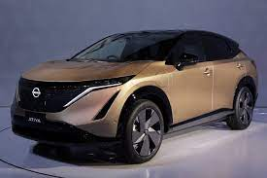
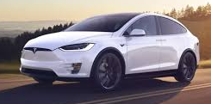
Terminology: Vehicle Choices
Plug-in Electric Vehicles (PEV)
  Plug-in Hybrid Electric Vehicle (PHEV)
    Run on electricity or gasoline
    Primary power source is electricity
    Internal combustion engine automatically
    engages when battery runs low
    Zero tailpipe emissions when running on battery only
    Gasoline ability alleviates range anxiety
  Battery Electric Vehicle (BEV)
    100% electric battery powered
    Range limited (Typ. 250 miles, up to 500 miles)
      Constrained by battery
    Zero tailpipe emissions
    Quiet
    Low maintenance cost
    Battery warranty (typ): passenger vehicle
      8 year/100,000 miles

Slide 5
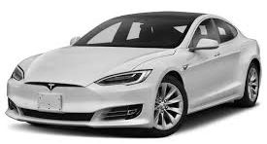
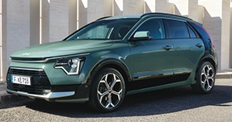
EV Models
“PEVs” often simply called “EVs”
Plug-in EVs (PEVs)
Battery EV (BEV), aka All Electric Vehicles
  48 models in Illinois
  250-mile range typical (Nissan, Chevy)
  325-mile range (Tesla)
  500-mile range (Rivian)
Plug-in Hybrid EV (PHEV), aka Extended Range EVs
  34 models in Illinois
  13-mile EV range min
  80-mile EV range max
  Up to 400-mile total range
EV counts per Plugstar
Notes:
PlugStar Shopping Assistant
Consumer Reports, “Hot New Electric Cars”
EV Database Webpage, “Newest EVs”
Consumer Reports, “Hot New Electric Cars are Coming Soon”, Jeff Plungis, Feb 20, 2020 , Retrieved July 18, 2020.https://www.consumerreports.org/hybrids-evs/hot-new-electric-cars-are-coming-soon/
Electric Vehicle Database Website, “EVs are Better” Retrieved July 18, 2020. https://ev-database.org/compare/newest-upcoming-electric-vehicle#sort:path~type~order=.date_from~number~desc|range-slider-range:prev~next=0~1200|range-slider-acceleration:prev~next=2~23|range-slider-topspeed:prev~next=110~450|range-slider-battery:prev~next=10~200|range-slider-eff:prev~next=100~300|range-slider-fastcharge:prev~next=0~1500|paging:currentPage=0|paging:number=9

Slide 6
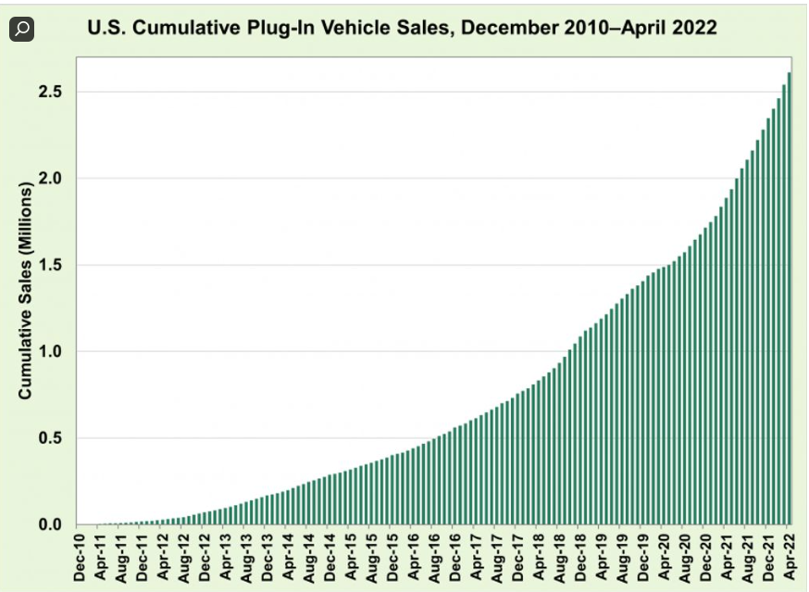
PEV Sales History
Number of vehicles
  US: 290 Million
  Global: 1.5 Billion
Plug in EVs Counts
  Global: 12 Million
  US: 3.8 Million – US (7/2023)
  New US Sales : 10% EVs in 2022 (passenger)
  80,000 Illinois (9/2023)
  Target: IL: 1 million by 2030
Several major cities, countries, automakers eliminating fossil fuel vehicles
Source: California Energy Commission, 2022
Source: Bloomberg New Energy Finance
Notes:
https://www.zippia.com/advice/how-many-cars-in-the-us/#:~:text=There%20are%20290.8%20million%20cars,the%20U.S.%20rose%20by%200.45%25.https://insideevs.com/news/583340/plugin-car-sales-california-us-2022q1/
https://www.statista.com/statistics/801263/us-plug-in-electric-vehicle-sales/
https://www.ilsos.gov/departments/vehicles/statistics/electric/2022/electric041522.pdf
More than nine countries and a dozen cities or states have announced what the media has called “bans” in the last few years. Copenhagen mayor Frank Jensen wants the city to end all new diesel cars starting next year. Last December, Paris, Madrid, Athens and Mexico City said they would remove diesel cars and vans by 2025. Norway will phase out conventional cars by 2025, followed by France and the United Kingdom in 2040 and 2050, respectively.
Volvo and Tesla – 100% electric
Nissan LEAF: 375,619
Tesla Model S: 253,078 (estimated)
Mitsubishi Outlander PHEV: 178,509
Chevrolet Volt (all versions): 176,767
BYD Qin (PHEV & BEV): 173,232

Slide 7
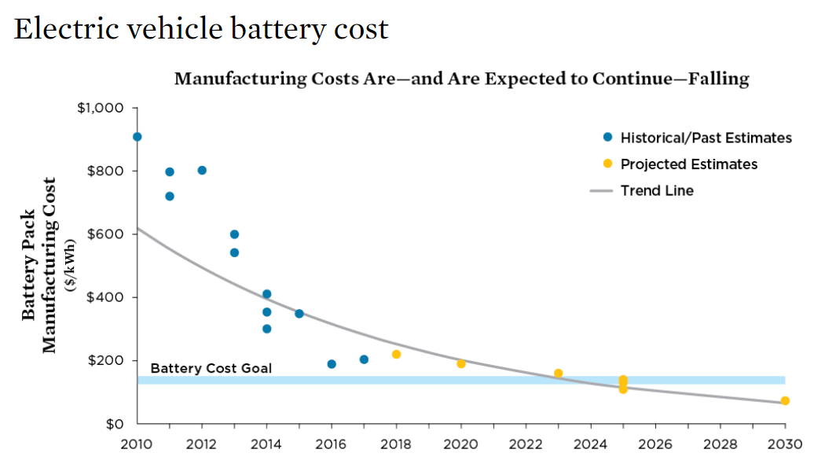
Battery Costs
Cost Parity
SOURCES: ARB 2017; SOULOPOULOS 2017; VOELCKER 2017; SLOWIK, PAVLENKO, AND LUTSEY 2016; VOELCKER 2016; NYKVIST AND NILSSON 2015.
Notes:
Along with auto manufacturers, the U.S. Department of Energy’s R&D program has significant cost goals…and the cost per kilowatt-hour of batteries has declined far faster than expected. Long range EVs were introduced many years ahead of schedule.
https://www.energy.gov/eere/vehicles/batteries
According to Bloomberg New Energy Finance, prices have declined over 70% from 2010 to 2016.
DOE’s goal is to get the cost of EV batteries to less than $100/kWh, increase range to 300 miles, and decrease charge time to 15 minutes or less.
Most analysts claimed lithium-ion battery technology was not capable of powering a robust market for long range vehicles. The belief was that new chemistries with much higher energy densities were needed for EVs to reach their full potential. While this may still be true for batteries to power all vehicles, the cost per kilowatt-hour of batteries has declined far faster than expected and resulted in long range EVs being introduced many years ahead of expert opinions. A good example is the 2012 and 2017 California Air Resources Board analyses for its ZEV program. The 2012 analysis assumed 100-mile BEVs would be the norm out to 2025 while the 2017 analysis assumes vehicles capable of traveling over 200 miles on a charge will be common in that timeframe.
Can reduce cost of EV batteries to less than $100/kWh, increase range to 300 miles, and decrease charge time to 15 minutes or less
Ultimate goal is $80/kWh for cost competitiveness
Current Battery Pack Cost Estimates from Two Automakers (Usable Energy)
GM: ~$220-235/kWh
Tesla: ~$223/kWh
http://www.automotivebusiness.com.br/abinteligencia/pdf/EV-Price-Parity-Report.pdf- cost parity
https://www.ucsusa.org/sites/default/files/attach/2017/09/cv-factsheets-ev-incentives.pdf?_ga=2.108452610.1630188791.1517413160-1434713090.1436805699SOURCES: ARB 2017; SOULOPOULOS 2017; VOELCKER 2017; SLOWIK, PAVLENKO, AND LUTSEY 2016; VOELCKER 2016; NYKVIST AND NILSSON 2015.

Slide 8
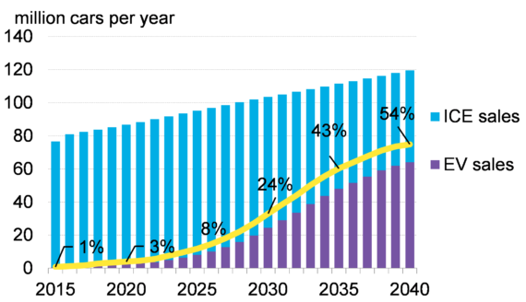
EV Sales Forecasts
Sources: Bloomberg New Energy Finance
Statistica.com
Notes:
https://www.statista.com/statistics/801263/us-plug-in-electric-vehicle-sales/
More than nine countries and a dozen cities or states have announced what the media has called “bans” in the last few years. Copenhagen mayor Frank Jensen wants the city to end all new diesel cars starting next year. Last December, Paris, Madrid, Athens and Mexico City said they would remove diesel cars and vans by 2025. Norway will phase out conventional cars by 2025, followed by France and the United Kingdom in 2040 and 2050, respectively.
Volvo and Tesla – 100% electric

Slide 9
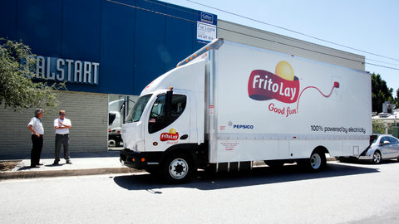
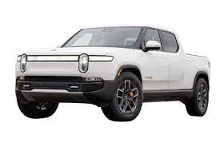
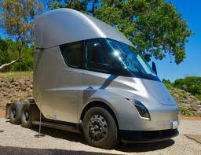
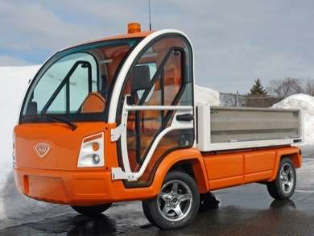
eTrucks
Delivery Van
Utility e-truck
  25 mph limit
Rivian R1T Pickup:
Tesla Semi
Notes:
http://www.trendhunter.com/trends/nemo-electric-truck : 25 mph max,
http://www.viamotors.com/vehicles/electric-truck/ 40 miles in all-electric mode with near zero emissions, and a full range of 400 miles on a single fill-up. Exportable power: 14.4 kW @60 A

Slide 10
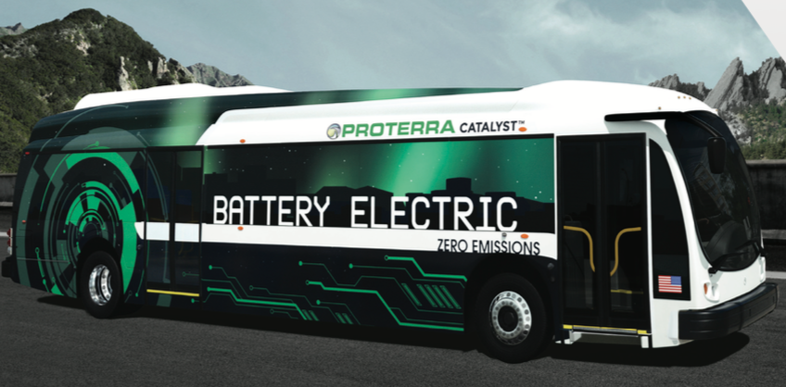
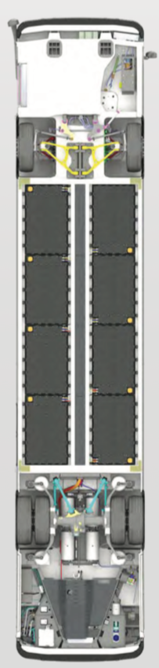

Electric Buses
Proterra BEV
BEV School Bus
Notes:
Newton (Smith) BEV eTrans travels up to 120 miles on a charge at speeds up to 50 mph

Slide 11

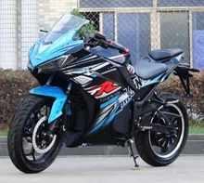
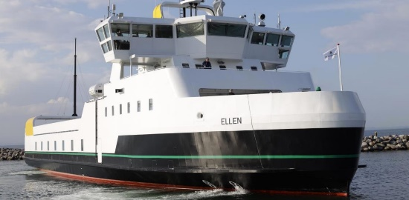
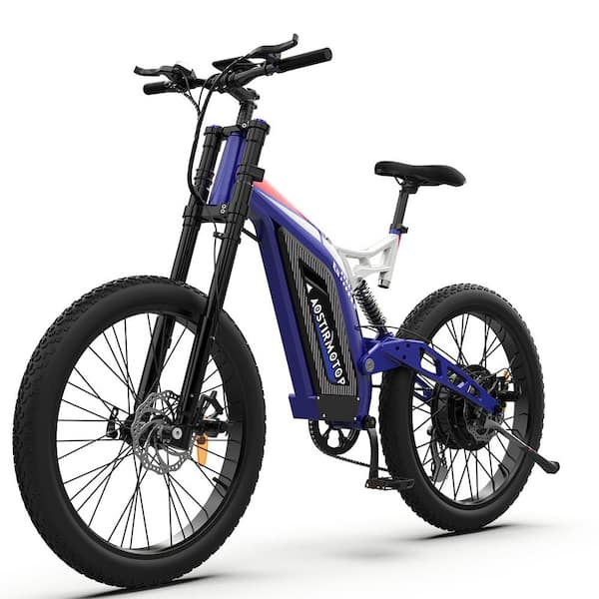

Electric Other
E Motorcycle
Electric
Airplane
Electric
Ferry
Electric
Locomotive
E-Bike
Notes:
Newton (Smith) BEV eTrans travels up to 120 miles on a charge at speeds up to 50 mph

Slide 12

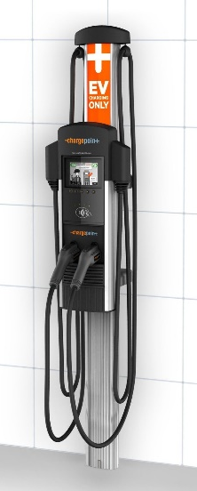
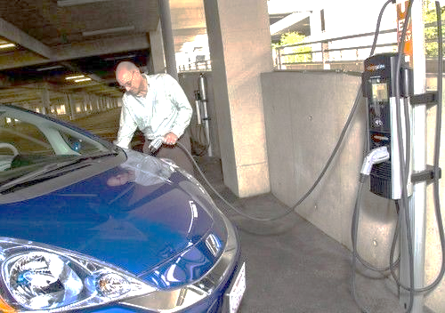
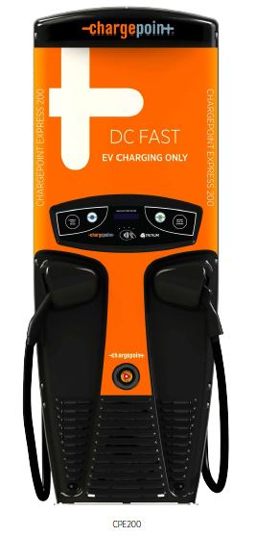
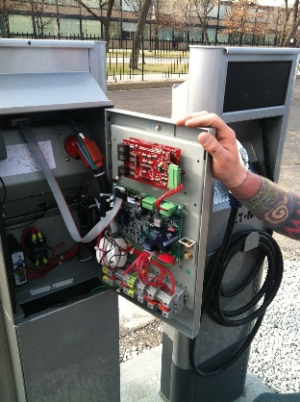
EV Supply Equipment (EVSE)
EVSE commonly called EV Charging Station
AC Charging: AC in AC Out
  Level 1: 110 VAC in and out of charging
  Level 2: 208/240 VAC in and out of charging
DC Fast Charging: AC in DC Out
  480⁺ VAC
  Sometimes called Level 3 charging

Slide 13

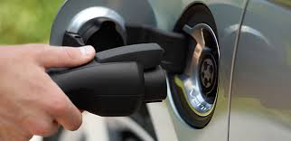

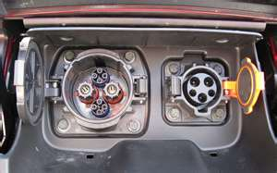

Connection Devices
Level 1&2 (AC Charging)
Standard J1772 Connector
All PEVs use
Tesla has their own plug & adapters to standard
DC Fast Charging
Combined Charging Standard (CCS) or CHAdeMO Connectors
Tesla has their own plug & adapters to standard

Slide 14
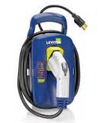
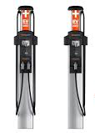
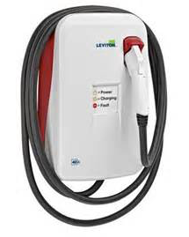
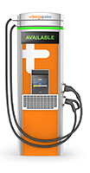
Range Miles per Hour Connected
Level 1: 3 to 5 (120 V)
Level 2: 16 to 80 (208/240 V)
DC Fast Charging: 75 to 300 (240 to 480⁺ V)
Recharge rate variables: Voltage and Amperage

Slide 15
Annual Cost to Charge
PHEV- 70% Electric Miles
Electricity
Gasoline
$4.00/gallon gasoline
$0.13 / kWh
15,000 mile/year
Maintenance costs ~1/3 for EVs compared to gasoline

Slide 16
EV Charging Infrastructure
Level 1 - need dedicated outlet.
  EV comes with Level 1 EVSE
  May have to add circuit
Level 2 – like a new electric appliance
  Likely need a contractor to run conduit and wiring
  Will need to buy EVSE ($500 to $1,000).
  Installation costs $500 to $2,000.
May need to upgrade utility service, new panel.
Site specific

Slide 17
EV Incentives
Electric Vehicle Rebate Act
  November 1- second offering
  opens
  Applies to new and used BEVs
IRS income tax credit
  Up to $7,500 / EV
  Up to $4,000/ used EV
  Up to $40,000 /commercial EVs (>14,000 lbs.)
  Credit applies to EVs up to $80,000
  Must meet built in US criteria
Date | Rebate Amount
7-2-2022 | $4,000
7-1-2026 | $2,000
7-1-2028 | $1,000
More INFO:
https://www.greenways2go.com/electric-vehicle-incentives
https://afdc.energy.gov/laws/search#/
Notes:
Programs that
Lower carbon dioxide emissions
Replace fossil fuel use
Create cost savings
Improve electric grid operations
Reduce increases to peak demand
Improve electric usage load shape
Align electric usage with times of renewable generation.
Programs provide incentives to encourage electricity use at times when
Usage of overall system is low
When generation from renewable energy sources is high

Slide 18






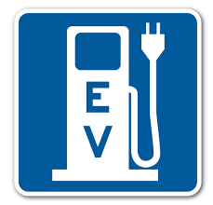




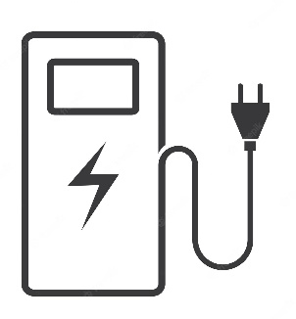


EV Charging Ecosystem
Work
Fleets
Home
DC
Public
Travel
Notes:
Tim’s last slide

Slide 19
EV Infrastructure Incentives
Goal: Creating ubiquitous charging access
= eliminate range anxiety
National Electric Vehicle Infrastructure (NEVI) Program.
  DCFC every 50 miles on most interstates
  80% cost coverage
  Program announcement pending
Charging and Fueling Infrastructure (CFI) Program for Alternative Fuel Corridors.
  Community and rural charging
  80% cost coverage
  Funding announcement pending
Illinois EV Charging Rebate – Dec 2023?
ComEd Beneficial Electrification – early 2024, up to $2,500 for residential

Slide 20
EV Charging Incentives
30% Federal tax credits for EV Charging – income qualified
IL EV Charging Rebate
  Up to 80% covered
  Public shareable
  Need to provide public access
IL Beneficial Electrification programs - ComEd may invest in some make ready infrastructure projects, tied to EV charging rates

Slide 21
Taking Steps
Test drive an EV
Learn about incentives
Evaluate cost of home charger
Take a step to mitigate climate change!

Slide 22

Providing EV Charging Solutions since 2012
      Consulting
      Turnkey design and build of EV charging projects
Tim Milburn
Chicago Area Clean Cities Steering Committee since 2017
Project Advisor for Metropolitan Mayors Caucus EV Readiness Project
Tim Milburn
847-826-3314
tim.milburn@greenways2go.com
www.greenways2go.com
Notes:
Have visited over 70 condo & apartment buildings in Illinois since 2014 to assess EV charging needs.. 1/3 in last year.

Slide 23

Thank you
Tim Milburn
847-826-3314
tim.milburn@greenways2go.com
www.greenways2go.com

